Slide 1
National Bioinformatics Infrastructure Sweden

Slide 2
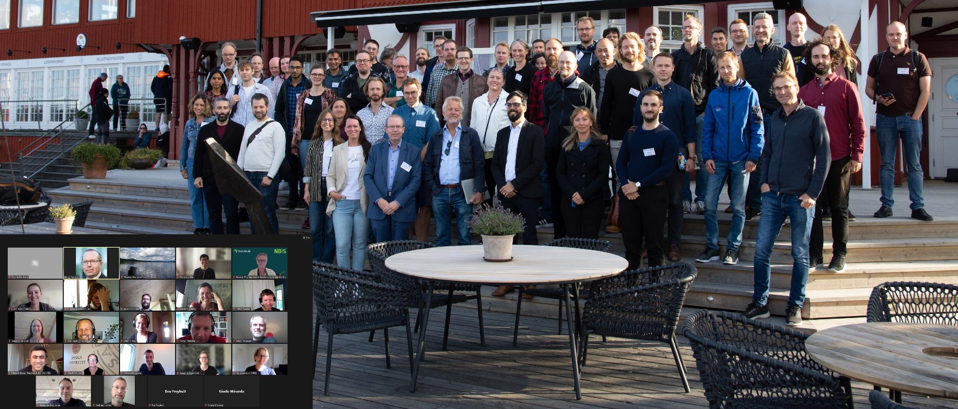
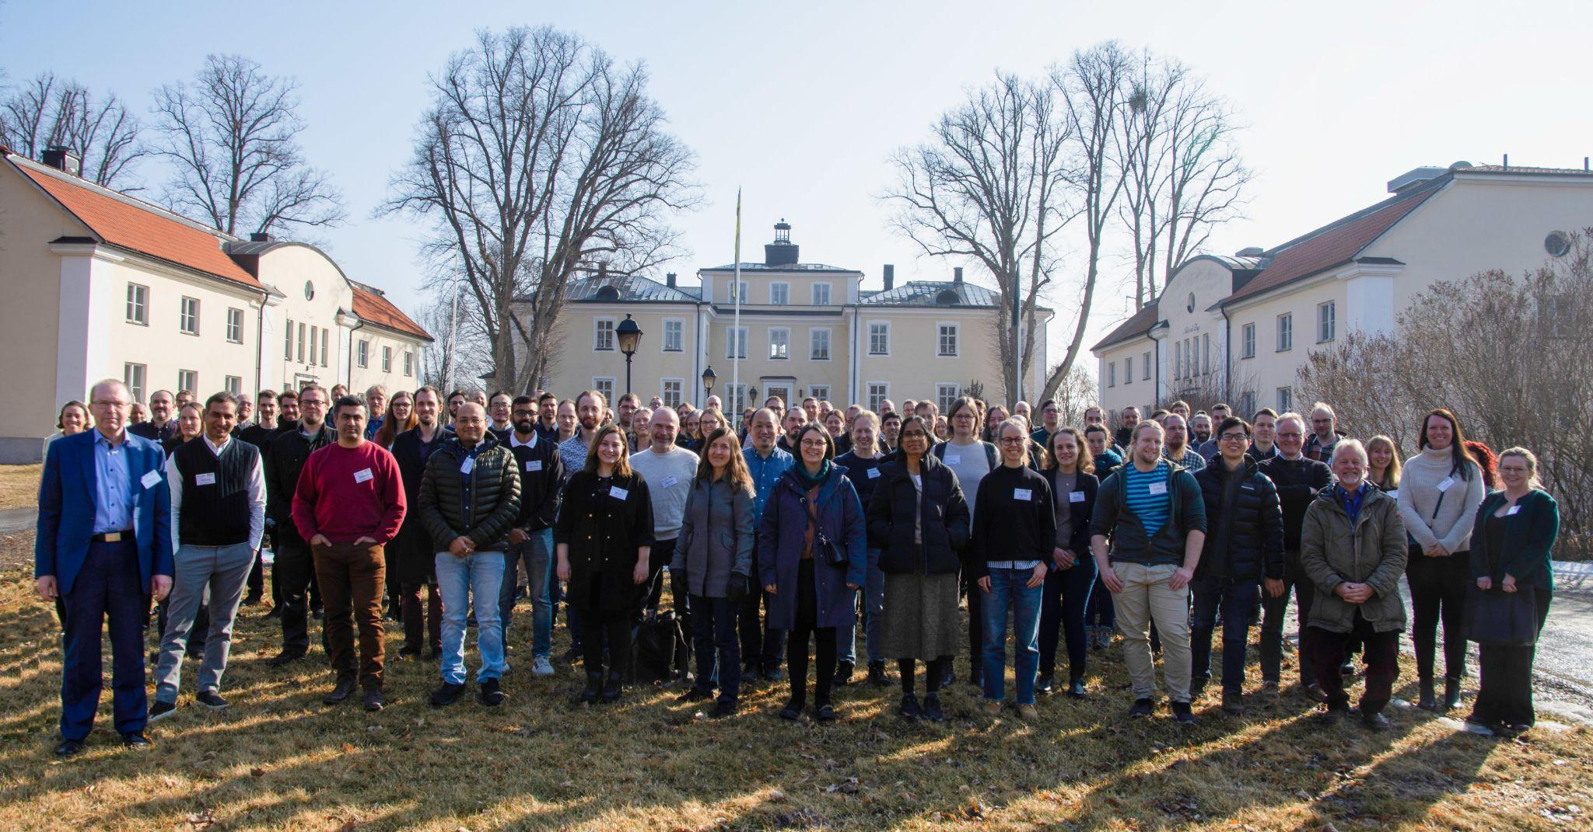
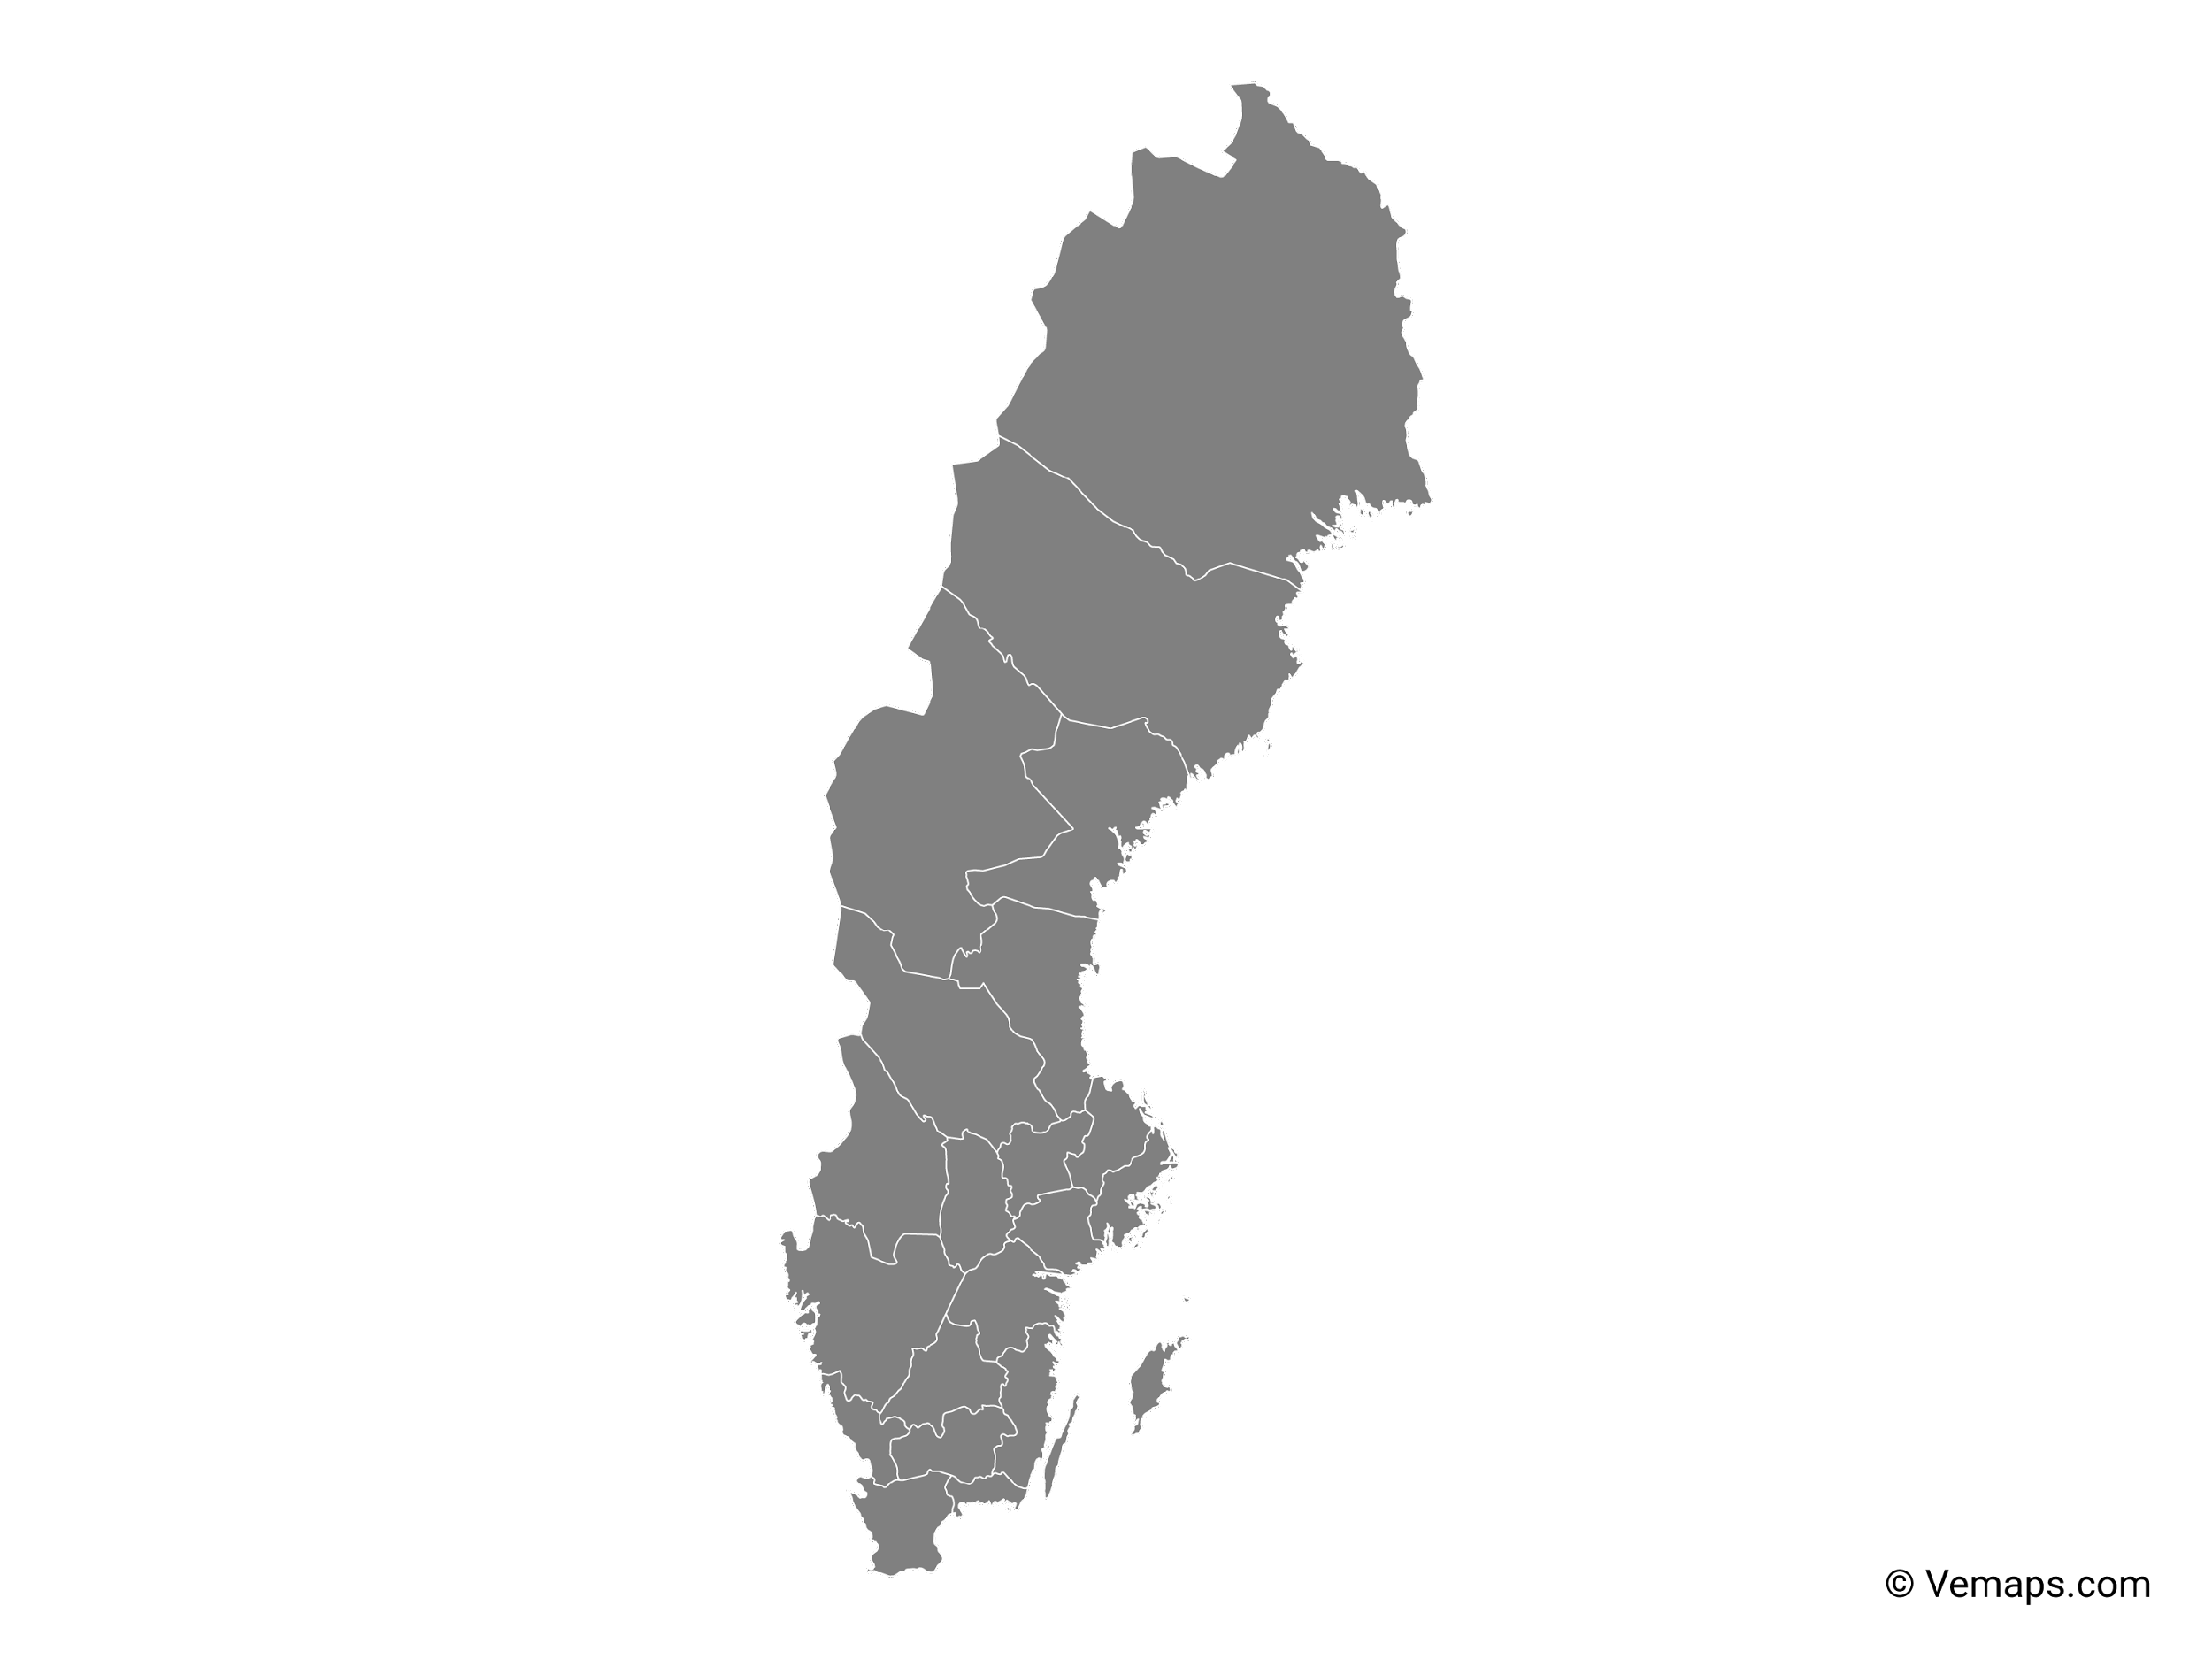
The SciLifeLab bioinformatics platform
Umeå
~100 staff at six different sites across Sweden with expertise in many different omics-related areas
Uppsala
Stockholm
Göteborg
Linköping
Lund
Notes:
National Bioinformatics Infrastructure Sweden (NBIS, https://nbis.se/) is a distributed Research Infrastructure located across 6 different sites in Sweden.
Distributed staff-scientists in teams such as Cell & Molecular Biology, Evolution & Biodiversity, Health & Clinical, Microbiology, Immunology & Structural Biology, Bioimaging Informatics, Systems development, AIDA (Analytic Imaging Diagnostic Arena) Data Hub, SCoRe (NBIS support for computational resources), Data management.
Expertise in e.g. proteomics, genomics, systems development, Artificial Intelligence, Machine Learning, data management, metabolomics, systems biology, data sharing (AIDA Data Hub)… [tailor what you say to your audience]

Slide 3



Core activities
‘To help the Swedish research community build knowledge in analyzing large and complex omics data and to make bioinformatics easily accessible for life science researchers’
Support services ranging from short consultations to long-term embedded bioinformaticians.
Providing infrastructure in the form of services, computational resources, tools and guidelines to the life science community.
Training events in advanced and applied bioinformatics.
Support
Infrastructure
Training
Notes:
3 main activities
Support is the biggest part of what we do (50% Support, 30% Infrastructure, 20% Training)

Slide 4



Support project stages
Support
Publication
Study design
Data generation
Standard analyses
Project-specific analyses
SciLifeLab Platform
or other data generator
Notes:
It would be great for the research to involve NBIS already in the beginning with Study Design
Involved since the beginning to make sure
the data is powered enough to answer the research questions
the study design is optimised for downstream data analysis
the data management planning
Other platforms generate the data and then we (NBIS) can help with the actual analysis of the project and publication of the research outputs

Slide 5
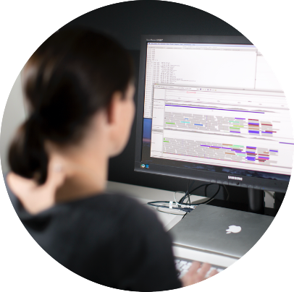
Bioinformatics support options
Support
Study Design &
Project Consultation
3 h per project
No hands-on work
Fee-for-service:
Short- or medium-term support
User fee 800 SEK/h *
All projects welcome, queuing system
Peer review:
Long-term support
500 h support over ~ 1-2 years, for free
Scientific selection by committee, 3 application rounds/year
Involvement from research group mandatory
Partner Projects
For projects with large bioinformatic component
“Hire” an NBIS bioinformatician
Full-cost model: utilize and pay for e.g. 50% of one NBIS FTE
*The BioImage Informatics Facility has a slightly different financing policy
Notes:
Different types of support available in NBIS, ranging from a drop-in questions session to a full partner project, up to 5 years of 50% FTE
(No need to read the sliide, the information is contained in the next slides)

Slide 6



Drop-in support
Support
Drop-in sessions
Ask your question!
Bioinformatics, sequencing, data management, and more
Online - Tuesdays at 14.00
Notes:
Talk about dropins and consultations (as two separate things)
The consultations are up to 3 hours for free - No hands on work
Any type of bioinformatics question can be brought to the drop-in. The person responsible for the drop-in will try to find the suitable expert for the question
** Possibly add QR code to drop-in zoom link or https://nbis.se/events/
** Add information about consultations

Slide 7
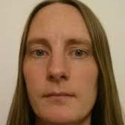
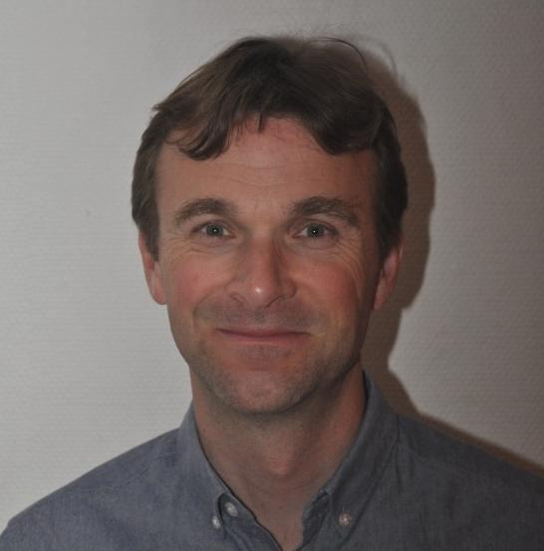

Fee-for-service
Support
Apply for hands-on support at nbis.se/support
Fee-for-service support - Short- and medium-term support
800 SEK/h
Typical projects 50-80 h, but many are longer
Application
Applications are handled continuously
All projects are welcome, queuing system
Data should be available at the time of application
Project coordinators match projects with NBIS experts based on competence and availability
Eva
Fredrik
Magnus
Notes:
About 30 staff
(Note: the fee is for the actual hours of work, can be less than what the contract says)

Slide 8
Peer review – Long-term support
Support
Support for free to selected projects
Typically 500 h
1-2 bioinformaticians will work in the project for 1-2 years
Involvement from the research group is mandatory to ensure knowledge transfer
Application
Projects are selected by an external committee based on scientific value
Three application rounds each year
Application form at nbis.se/support
Funded by Knut and Alice Wallenberg Foundation
Also known as Wallenberg Advanced Bioinformatics Infrastructure (WABI)
Notes:
About 30 staff
Next deadline: X/Y

Slide 9
Partner projects
Support
For projects with large bioinformatic component
Requiring NBIS support staff of at least 12 person months
Running over 2-5 years calendar time
Full cost model
NBIS will apply a standardised salary level and indirect cost model for the NBIS staff
Application
Applications are handled continuously; nbis.se/support
”Hire” an NBIS bioinformatician, utilize and pay for e.g. 50% of one NBIS FTE
Notes:
Notes:
Preferably discussed and agreed before a project applies for funding from a funding agency
NBIS salary costs specified in the proposed budget
Possibly with NBIS as a co-applicant in the proposal, if applicable

Slide 10
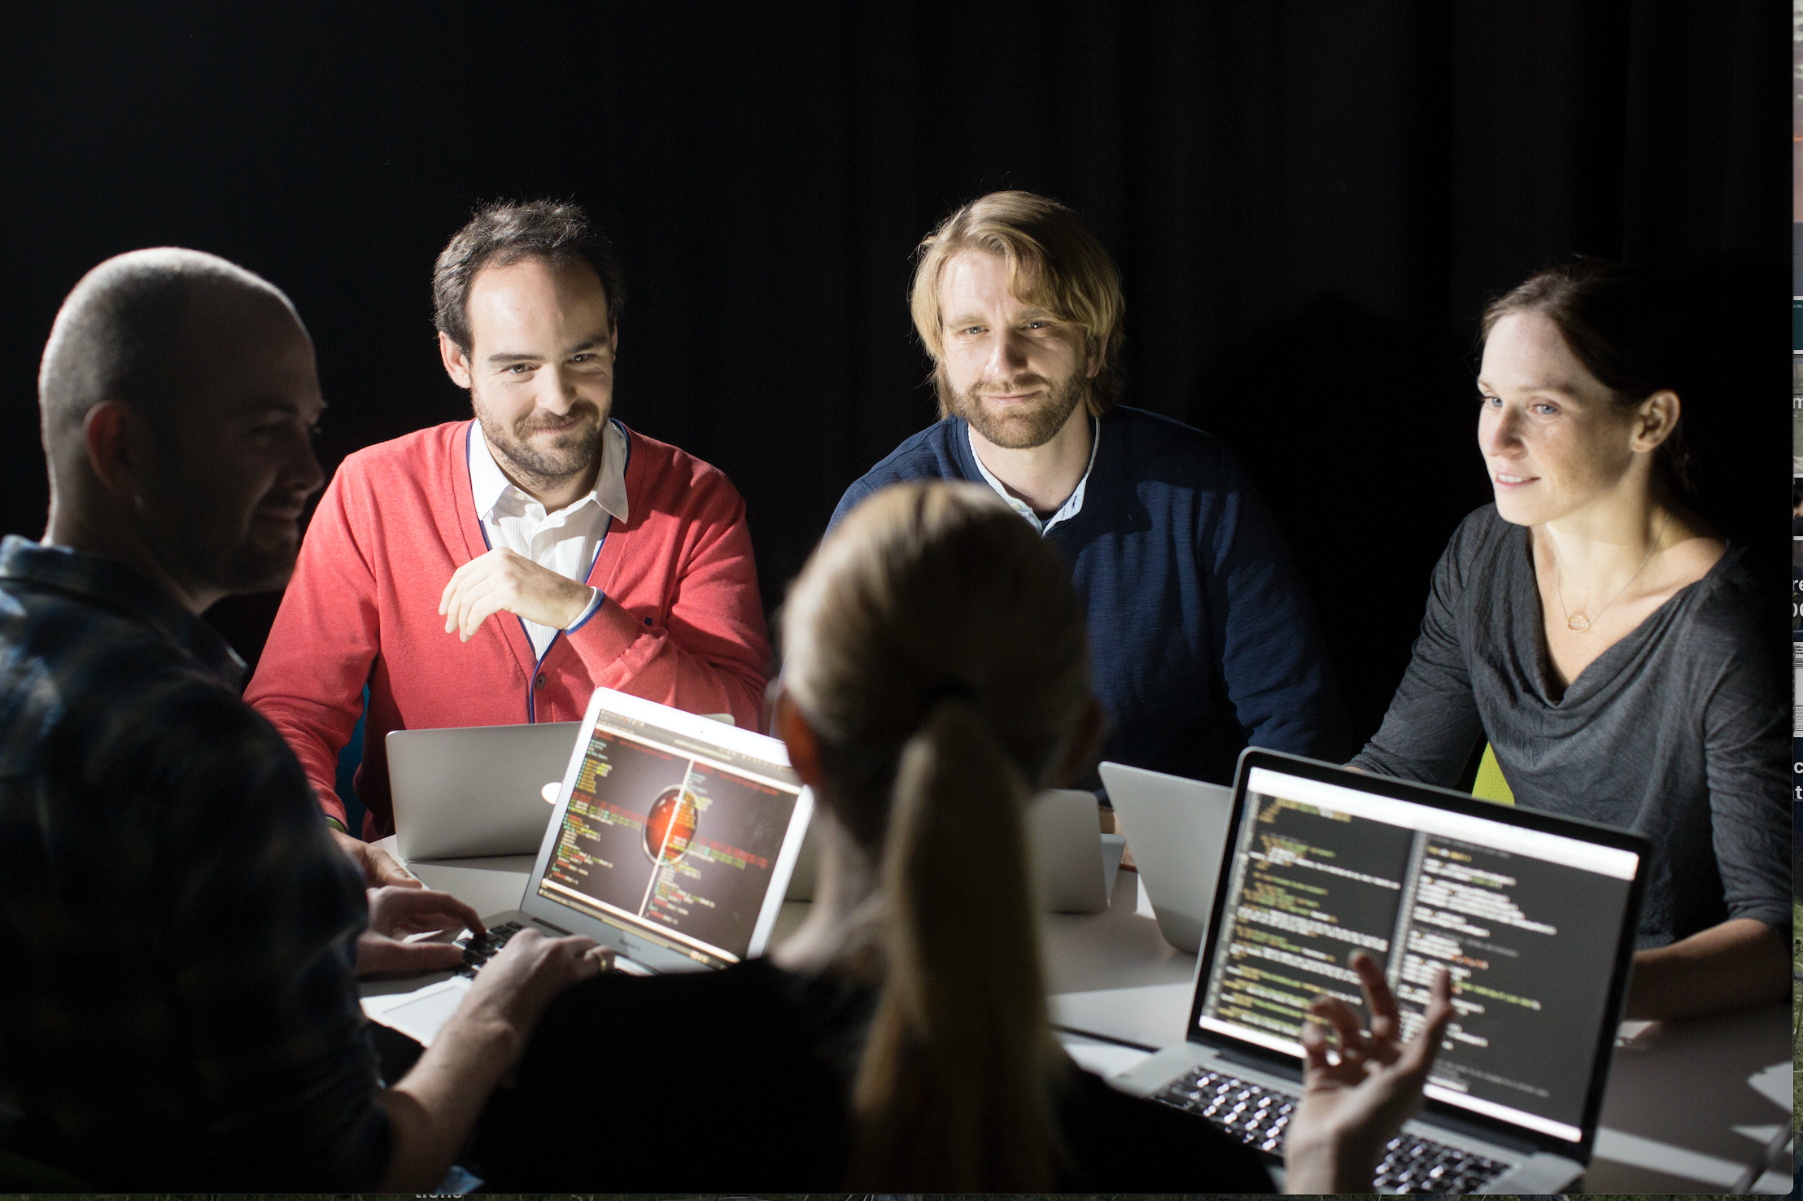

Applying for support
Support
nbis.se/support
Notes:
Find out more information and apply for support at our website, nbis.se/support (Note! Link might change with new website)

Slide 11
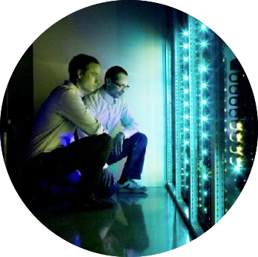
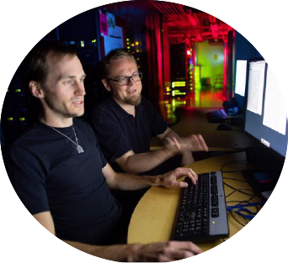
Infrastructure
Infrastructure
Systems Development
Create tools for efficient research
and sharing of results
Support for Computational Resources
(SCoRe)
Linking NBIS with UPPMAX
Application experts
Data Management
Data Management support to projects
Data stewards
AIDA Data Hub
Compute service for sensitive personal data
Data sharing services for citable datasets
Notes:
In addition to Support, NBIS also develops a lot of infrastructure.

Slide 12
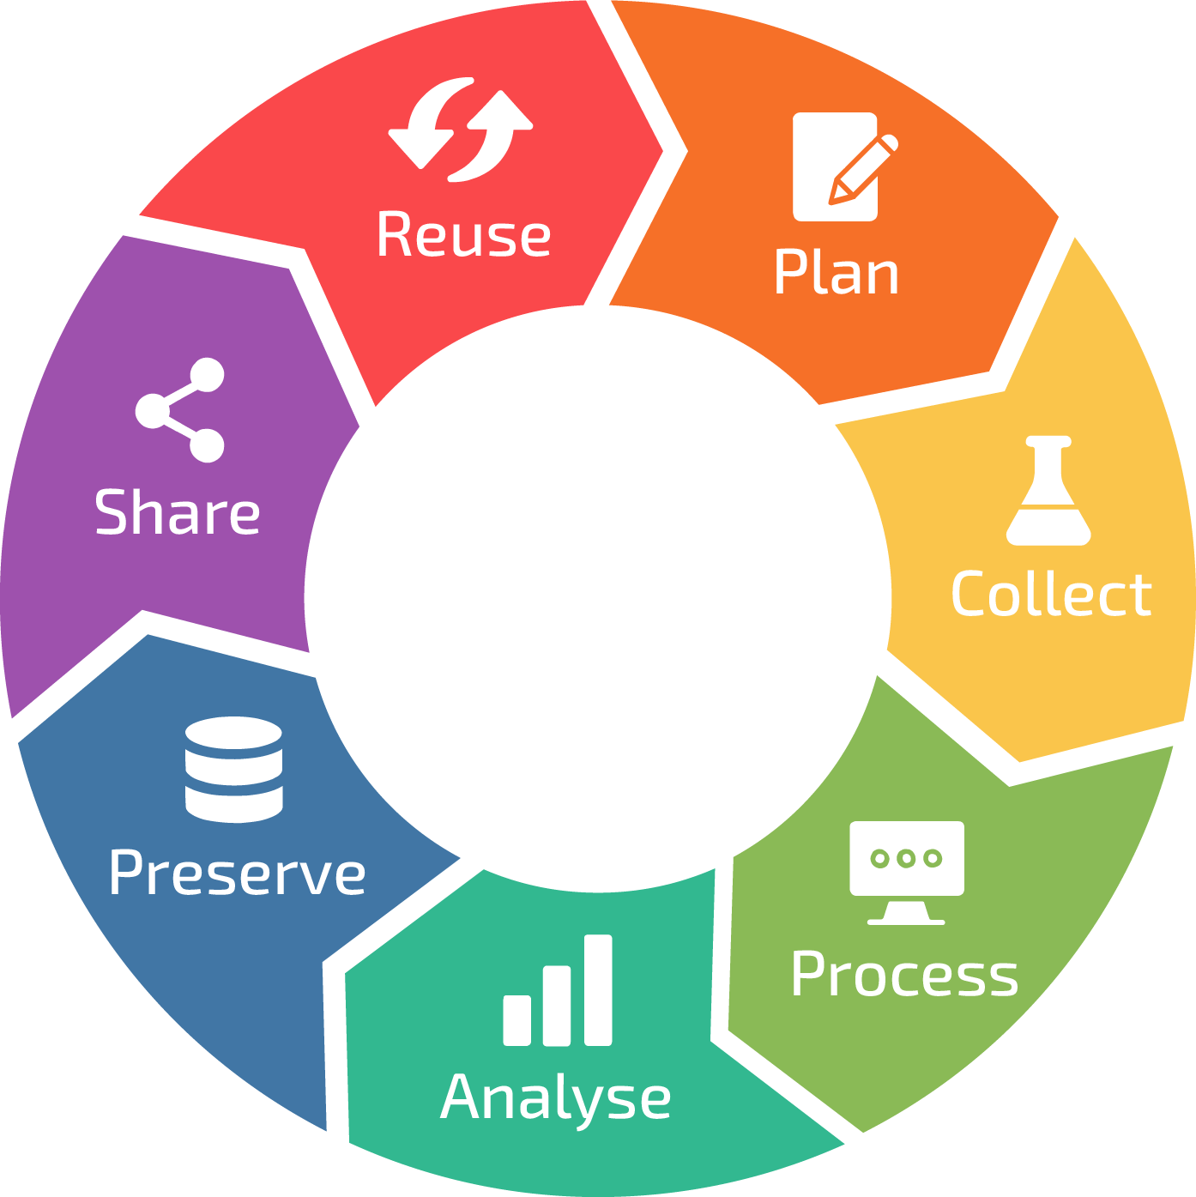

Data management support
Infrastructure
Data management plans
Data publishing
FAIR data
Sensitive data - FEGA helpdesk
Good DM practice
Data handling
Courses
Guidelines
Templates & Tools
NBIS Drop-in support and consultation https://meet.nbis.se/dropin
SciLifeLab RDM Guidelines data-guidelines.scilifelab.se
Meet a Data Steward Q&A scilifelab.se/event/meet-a-data-steward/
Notes:
FAIR = We can assist in providing guidelines and tools for increasing data Findability, Accessibility, Interoperability, and Reusability NBIS Data management team offers hands-on support, tools and guidelines throughout the data life cycle for, for example: - Selecting suitable repositories for different data types
- Publishing data in repositories - Writing data management plans
How to use the Data Stewardship Wizard platform
Review and improve existing data management plans
- Advice and/or hands-on for data transfers
You can find guidelines, links to training material and resources as well as support at SciLifeLab RDM guidelines, or join NBIS weekly drop-in for personal advice. Once a month there is a RDM-specific drop-in with a mini-lecture called “meet a data steward” which also has a 45 min Q&A session for individual advice.

Slide 13
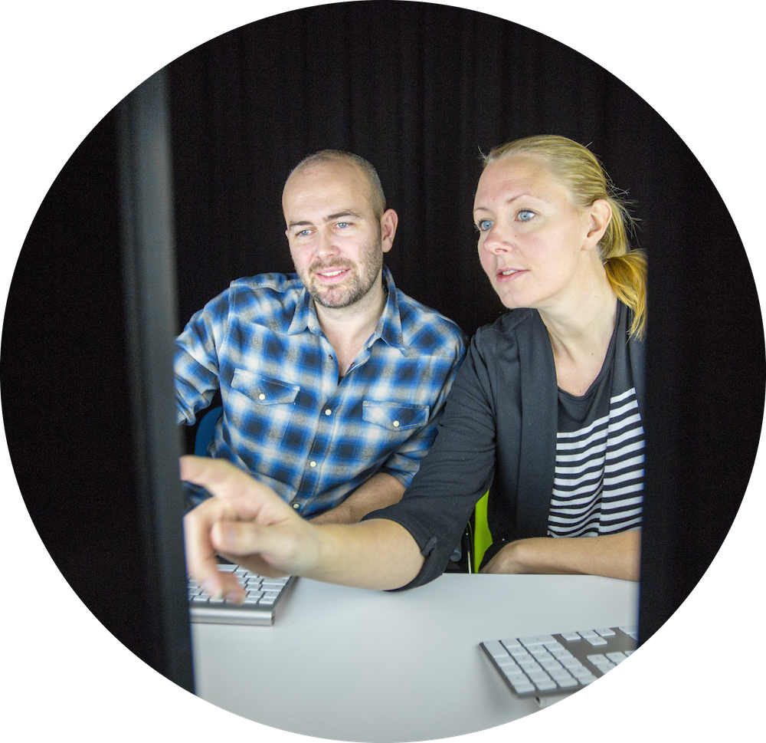
Training
Training
Courses
Several courses, mainly for PhD students and PostDocs
Led by experienced bioinformaticians
Teacher-dense
Theory and practice of state-of-the art methods
International courses together with Elixir
Advisory program
PhD students get a bioinformatician as advisor during 2 years
New students accepted once per year
Notes:
(The courses and advisory program are explained in the next slides - Briefly mention them and move to next slides)

Slide 14
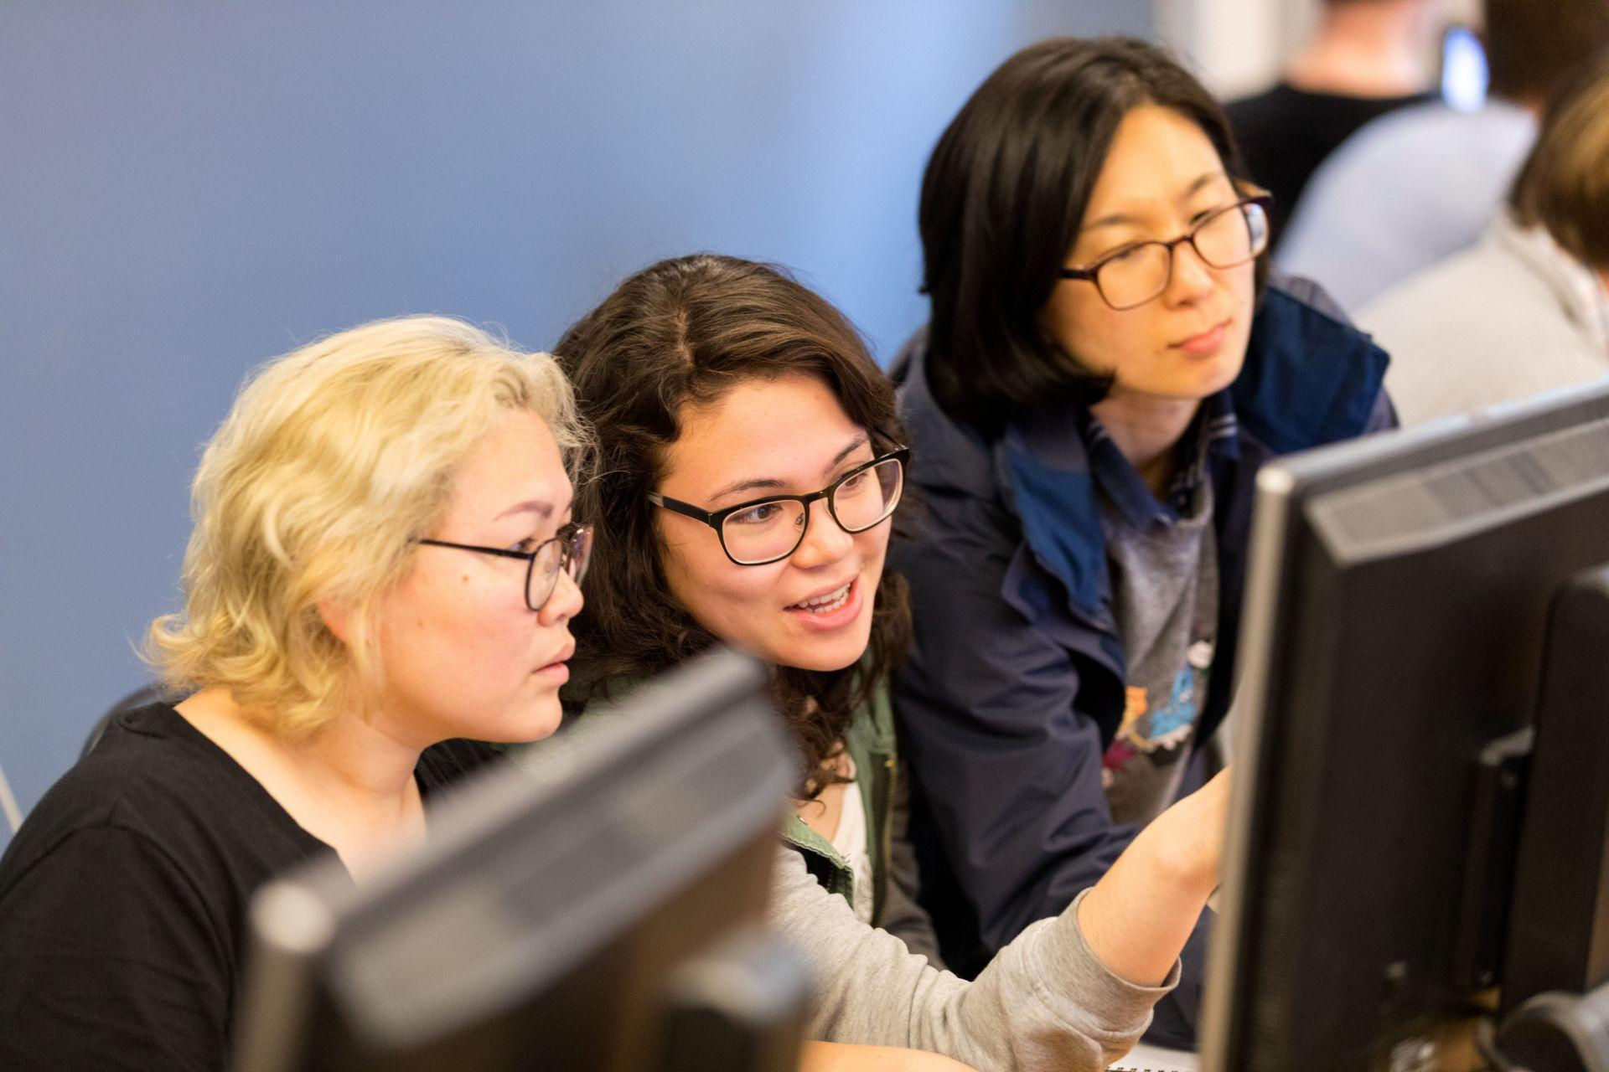

Training
Training
Courses catalogue
Introduction to bioinformatics using NGS data
Data management practices
Bulk and single-cell RNA-seq
Python and R programming
Tools for reproducible research
Omics integration and systems biology
Biostatistics and machine learning
Epigenomics data analysis
… and more!
Course calendar: https://nbis.se/training/events.html

Slide 15
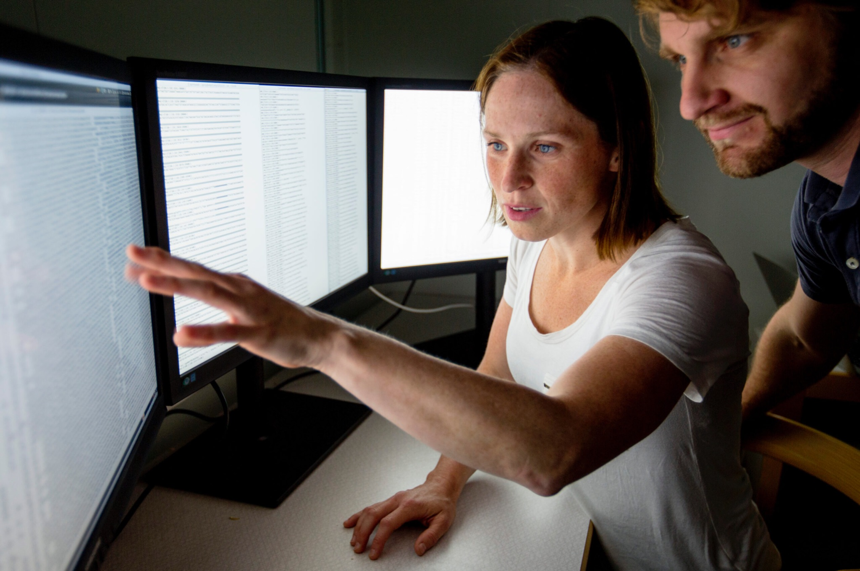
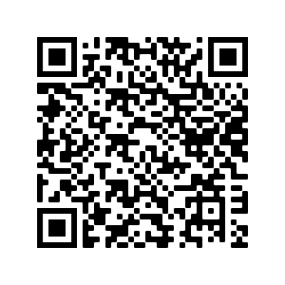
Bioinformatics advisory program
Training
The Swedish Bioinformatics Advisory program
Idea
PhD students get a bioinformatician as a personal advisor for 2 years
Complementing PhD supervisors with technical expertise
How
Monthly meetings with advisor
Grand meetings with all students and PIs
Apply
One application round per year, usually in December
https://www.scilifelab.se/training/the-swedish-bioinformatics-advisory-program
Notes:
The advisory program is a good opportunity for PhD students to have a personal bioinformatics mentor for 2 years. The program includes monthly meetings with the advisor and 2 grand meetings where all students in the program join together with their advisors and PhD supervisors.

Slide 16
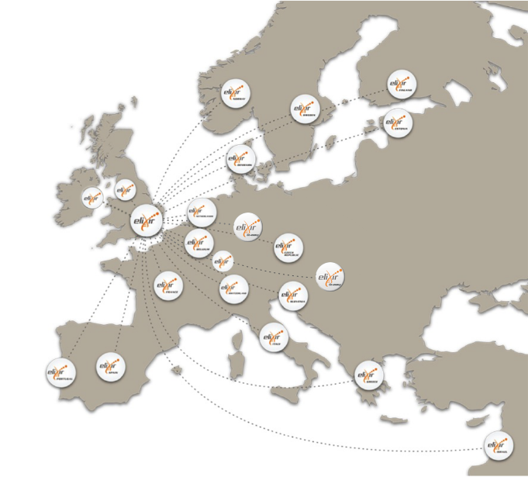
Elixir
ELIXIR is the European infrastructure for biological information
23 member nations, >250 research institutes
NBIS coordinates the Swedish ELIXIR node
Data
Tools
Interoperability
Training
Computing
Notes:
(Add QR code to TeSS and Elixir page too?)
ELIXIR is a European life sciences infrastructure, bringing together scientists from 23 countries and over 250 research institutes.
NBIS is the coordinator of the Swedish node
ELIXIR coordinates and develops life science resources across Europe so that researchers can more easily find, analyse and share data, exchange expertise, and implement best practices. This makes it possible for them to gain greater insights into how living organisms work.

Slide 17
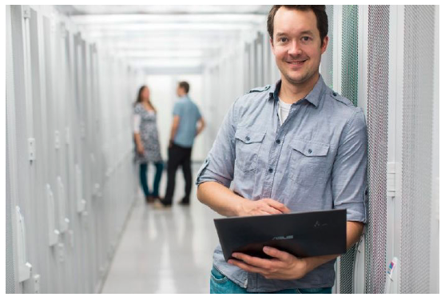

Welcome to contact us!
www.nbis.se

